Slide 1
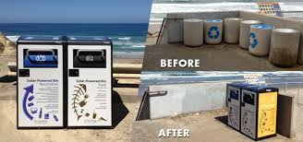
Menemsha Beach Wi-Fi
April 19th 2016

Slide 2
Roles of Each Party
Town of Chilmark
• Facilitate municipal approvals including RFP, franchise, permitting, etc.
• Signs trial agreement with ATC for deployment and operation of Bigbelly Telecom Trash Stations
• Reviews and approves plans
• Provides free power access
AMERICAN TOWER
• Contracts with the Town
• Owns all infrastructure
• End-to-end Wi-Fi customer management
• Designs, funds, and installs solution
• Handles all network operations, including IP connectivity
Bigbelly
• R & D for Telecom Station
• Sell ATC with 4 fit for purpose stations
• Assist town on waste operations
• Installation and launch
• On-going optimization of Wi-Fi network and Bigbelly unit issue resolution
A public private partnership that benefits all parties

Slide 3
TelecomTrash Stations Solution
Responsibility Matrix
Chilmark
ATC
Bigbelly
 |  | Responsibility |  | Responsibility |  | Responsibility
Site Acquisition |  | ü |  | ü
Wi-Fi Equipment |  |  |  | ü
Equipment Room (DAS Headend) |  |  |  | ü
Fiber |  |  |  | ü
Permitting |  | ü |  | ü
Telco |  |  |  | ü
Bigbelly Stations* |  |  |  | ü |  | ü
Power AC |  | ü
Power DC |  |  |  |  |  | ü
Wi-Fi Operations |  |  |  | ü
* Opportunity also exists to test small cell configurations
Notes:
Visual showing ownership based on ATC’s product lines

Slide 4
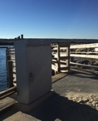
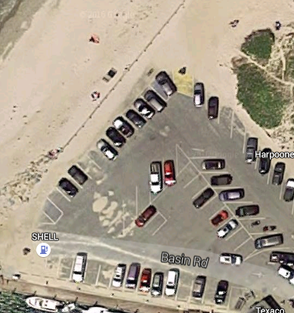
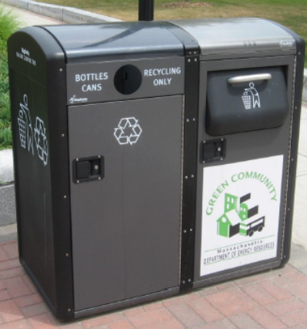

Menemsha Beach Network Diagram
Beach
3
4
Harbor
Wireless
Backhaul
Commercial Area
Open Natural Area and Residential
4 Nodes
Wireless
Backhaul
2
1
Outdoor DAS node 5
Wireless
Backhaul
Fiber
Utilize DAS Fiber to ATC MV ER

Slide 5
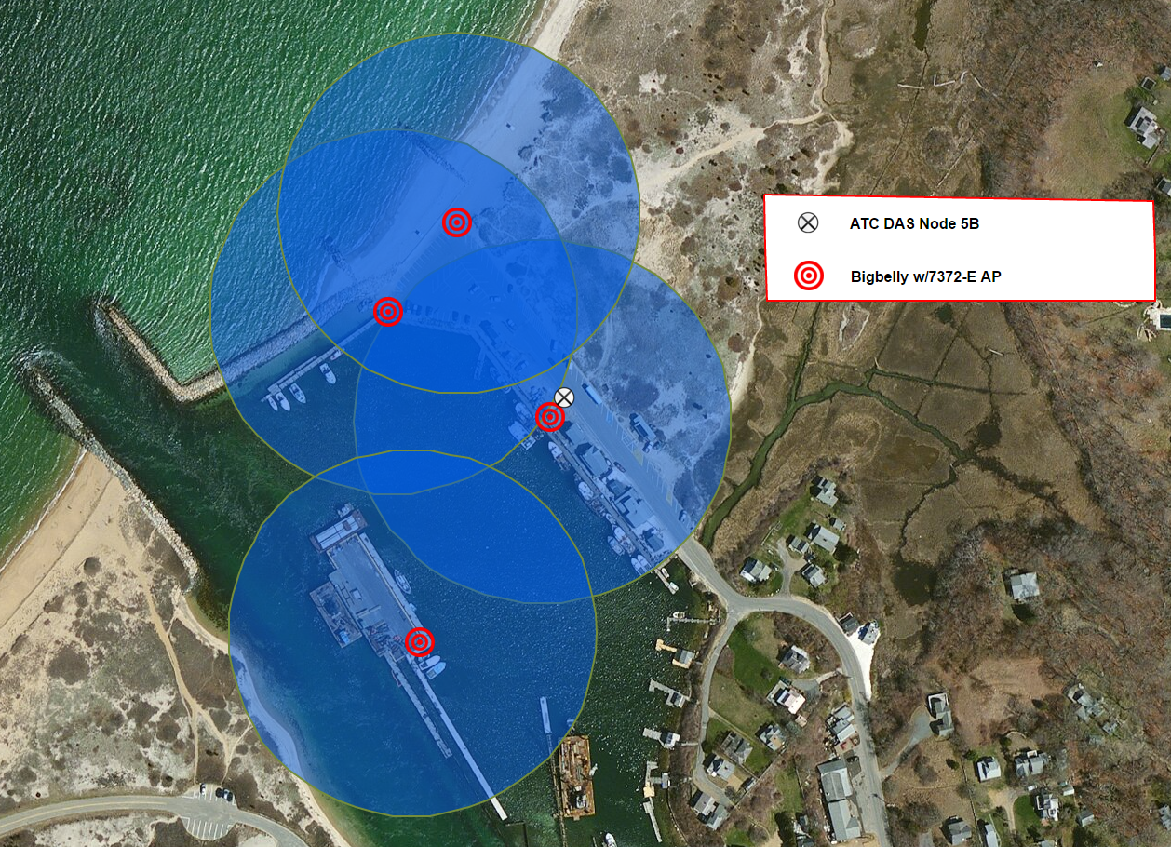
Menemsha Beach Network Coverage Map
Call Dari Fitzpatrick for the pole. Update legend for wireless bridge

Slide 6
Key Project Business Arrangements
ATC:
ATC completes all engineering work
ATC will pay for the commercial grade network and its construction/deployment
ATC will pay to operate and maintain the network
ATC will pay for backhaul circuit
ATC will pay for creation of User Captive Portal Splash Page
ATC will sell the service and keep all associated revenues
FOR THE CITY: ATC will provide a commercial grade network SSID that meets the cities needs at no cost.
Chilmark:
Provides approval for 3 locations to install the network at no cost.
Provides power at those three locations at no cost.
Provides approval for modifications of Node 5B to support the network at no cost.
Bigbelly:
Builds and installs custom Stations (per agreed station spec)
Facilitate bracketing of Wi-Fi equipment onto Stations
Onboard Chilmark for use of Station for waste management purposes
Full warranty coverage & use of CLEAN platform for pilot term
Monitor station power consumption

Slide 7





Key Launch Milestones
Key Milestones
January 2016 | February 2016 | March 2016 | April 2016 | May 2016 | June 2016 | July 2016 | August 2016 | September 2016 | October 2016 | November 2016
Phase 1 - Development
Phase 2 - RFP
Phase 3 - Deployment
Phase 4 - LAUNCH
Phase 4 - Summer Evaluation
Phase 5 - Post launch analysis
Phase 1 - Planning
Completed
In-Progress
Missed Deadline

Slide 8
Project Budget
Solution includes all critical components to support Wi-Fi deployment
One Time Non-Recurring Charges
Head End Prep (use existing MV headed) | $5,000
Front haul to nodes (use existing MV fiber) | $0
Construction of Nodes (no cost provided by city) | $30,000
•Non-Recurring -Node Equipment $2,300 per/node | $10,512
•Non-Recurring - Back Office Equipment | $13,411
•Non-Recurring – 4 Bigbelly Stations | $27,796
•Non-Recurring – Bigbelly NRE | $33,600
 | $119,119
Total Non-Recurring = $120,319
Monthly Recurring Charges
Backhaul Pricing (Comcast 150/20 MBPS) | $ 300
Ruckus Node Equipment Support | $ 15
Wi-Fi Portal and Retail Management (Leverage Boston Wi-Fi Single Digits) ($20 per AP w/ 8 AP’s) | $ 160
Power (Node power provided by city) | $ 0
City Attachment Fees (provided by city) | $ 0
MRC = 475

Slide 9
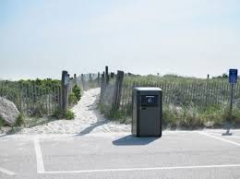
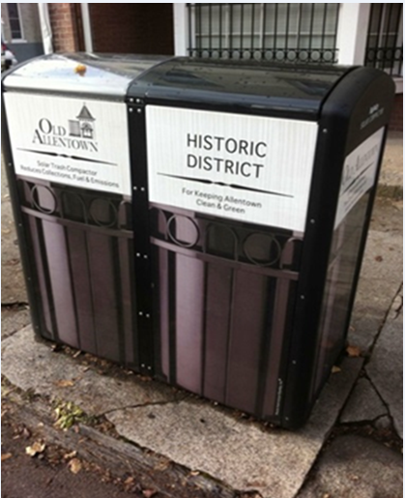
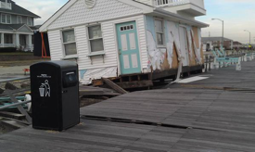
Bigbelly at the beach…

Slide 10

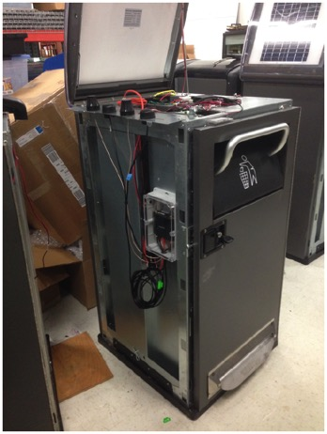
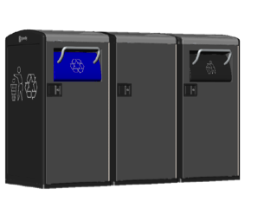
Bigbelly Station Configuration
CORE+ Cloud Control Module
400 Wh Battery Bank
2.4/5 GHz Wi-Fi Antennas
Ruckus 7372-E AP & Enclosure
2 - 40W Solar Panels
Smart Recycler
Telecom Cabinet
Waste Compactor

Slide 11
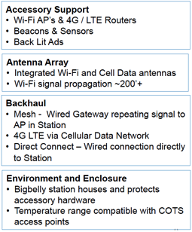

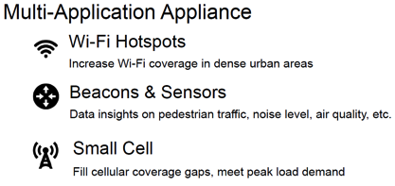
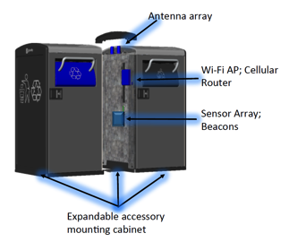
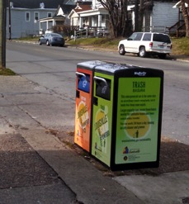
Bigbelly – Extensible Host Platform

